Slide 1
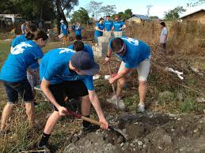
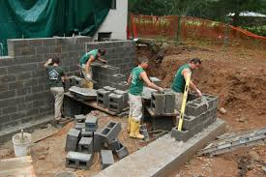
TC Roberson High School Building a Strong Professional Learning Community: Strengthening our Foundation
October 28, 2014

Slide 2
1. By the end of this session, Participants will be able to report: (a.) Why (critical importance) TCRHS must shift to a collaborative structure/culture (b.) The four guiding questions of an effective PLC and the school & team-behaviors that answer these questions 2. Participants will be able to identify where their team exists on the PLC Continuum and develop a team-goal for advancement on the continuum in the 2014-2015 school-year.

Slide 3
Effective learning communities reach students who struggle to learn!

Slide 4
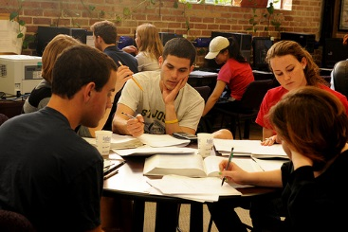
Effective PLCs Provide Struggling Learners with:
Additional time
Additional support
Targeted support
Alternate/Additional approaches to learning
Support from a team of teachers
A WHOLE school approach to achievement

Slide 5
PLC Defined:
An on-going process in which educators work collaboratively in recurring cycles of collective inquiry and action to achieve better results for the students they serve
An effective PLC operates under the assumption that the key to improved learning for students is continuous job-embedded learning for educators
Adapted from DuFour, DuFour, Eaker, & Many (2010)

Slide 6
Growing evidence suggests that this kind of professional development not only makes teachers feel better about their practice, but it also reaps learning gains for students, especially in the kinds of more challenging learning that new standards demand (Darling-Hammond 1997, NFIE 1996). Creating a profession of teaching in which teachers have the opportunity for continual learning is the likeliest way to inspire greater achievement for children, especially those for whom education is the only pathway to survival and success.
Linda Darling-Hammond, 1998

Slide 7
To Advance Student Learning,
Collaborative Teams Must Ask
4
Guiding Questions:

Slide 8
1. What do we want students to know/learn?

Slide 9
2. How do we know if students have learned it (or not learned it)?

Slide 10
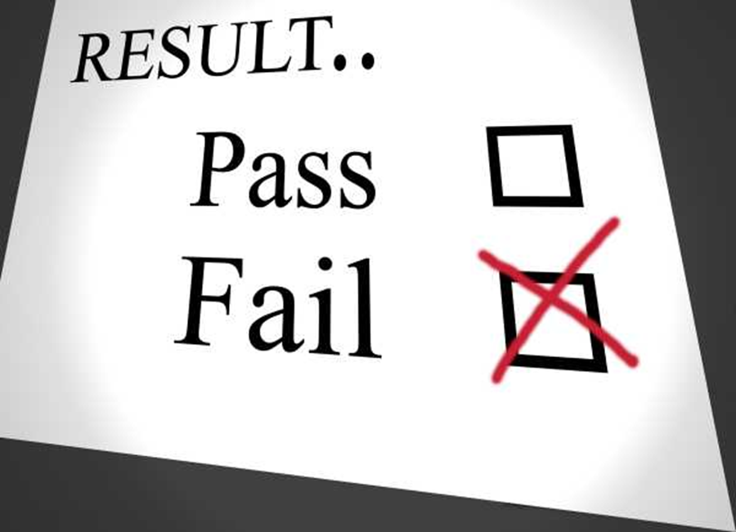
3. How do we respond when students do not learn it?

Slide 11
4. How do we respond when students do learn it?

Slide 15
What do teachers think of PLCs?
Teachers at Adlai Stevenson High School outside of Chicago...
“…feel more fulfilled, more rewarded, and more effective than teachers in traditional schools. A number of books have been written about the school (see Joan Richardson, Mike Schmoker, Tom Sergiovanni, Terry Deal, Thomas Lickona) and they invariably report on the enthusiasm, professionalism, and high morale of the faculty…”
Richard DuFour

Slide 16
Singletons
Good News!
Ms. Rhoney and your team understand your concerns and are committed to setting expectations for you that align with best practice for students. NO FAKE PLCs!
How do we avoid fake PLCs? Ask yourselves this question:
What is my motivation for being on this team? Am I on this PLC team in order to: (a) become a member of a PLC team, or (b) become a more effective teacher to improve the learning levels of my students?

Slide 17
Singletons Continued…
More Good News!!
The district has already seen the need for singletons across the district to come together
Your leaders at TCR and district leaders are working to find ways to increase opportunities for digital PLCs
Singleton Teachers: Help Lead the Way!
allthingsplc.info (blog: adjust for small schools and singletons & build consensus)

Slide 18
Resources to continue developing your team’s capacity…
Allthingsplc.info
Learningforward.org

